Slide 1
Rational model of categorization
CS786
15th April 2022

Slide 2
Setup
People behave as if they are storing prototypes sometimes
Category judgments evolve over multiple presentations
Sensible thing to do in situations where the category is not competing with others for membership
People behave as if they are storing exemplars sometimes
Probability matching behavior in describing category membership
Sensible thing to do when discriminability at category boundaries becomes important
Shouldn’t we have models that can do both?

Slide 3
A Bayesian observer model of categorization
Want to predict category label c of the N^{th} object, given
All objects seen before and
Their category labels
Sequential Bayesian update
Assumption: only category labels influence the prior. Can you think of situations when this would be broken?

Slide 4

Connection with classic models
Remember the GCM category response calculation?
Look at the numerator of the Bayesian model
Likelihood
Prior
Prior
Likelihood
Let’s call this likelihood L_{N,j}

Slide 5


A unifying view
In an exemplar model
In a prototype model
Crucial insight
Prototype model is a clustering model with one cluster
Exemplar model is a clustering model with N clusters
https://hekyll.services.adelaide.edu.au/dspace/bitstream/2440/46850/1/hdl_46850.pdf

Slide 6

The clustering view of categorization
Stimuli are grouped in clusters
Clusters are associated with categories
Either non-exclusively (Anderson’s RMC, 1992)
Or exclusively (Griffiths’ HDP, 2006)
Now the likelihood can look like
First proposed as the varying abstraction model (Vanpaemal et al., 2005)

Slide 7
How many clusters need we learn per category?
Deeply related to the non-parametric Bayesian question of how many clusters we need to fit a dataset
Problem addressed by Anderson’s Rational Model of Categorization (RMC)
Modeled category learning as a Dirichlet Process

Slide 8


RMC: big picture
Treat categories as just another label for the data
Category learning is equivalent to learning the joint distribution
Learn this as a mixture model
p(z_{N}) is a distribution over all possible clusterings of the N items
http://blog.datumbox.com/the-dirichlet-process-the-chinese-restaurant-process-and-other-representations/

Slide 9
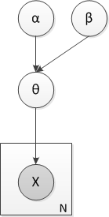
Coin toss example
Say you toss a coin N times
You want to figure out its bias
Bayesian approach
Find the generative model
Each toss ~ Bern(θ)
θ ~ Beta(α,β)
Draw the generative model in plate notation

Slide 10
Plate notation
Random variables as circles
Parameters, fixed values as squares
Repetitions of conditional probability structures as rectangular ‘plates’
Switch conditioning as squiggles
Random variables observed in practice are shaded

Slide 11
Conjugacy
Algebraic convenience in Bayesian updating
Posterior ← Prior x Likelihood
We want the distributions to be parametric, the parameter is what is learned
we want the posterior to have the same parametric form as the prior
Conjugate prior = f(.) such that f(θ)g(x|θ) ~ f(θ^{new})

Slide 12
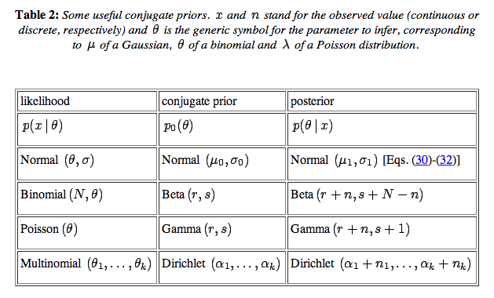
Useful conjugate priors
This one is important for us

Slide 13
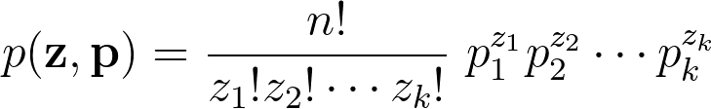
The multinomial distribution
For n independent trials that could yield one of k possible results, the multinomial distribution gives the probability of seeing any particular combination of outcomes
Each point can go into one of k clusters
z_i is the number of points in each cluster for the immediate observation
p_i is the fraction of points in each cluster in the long run
Given 3 clusters A,B and C, with normalized empirical frequencies [0.3, 0.4, 0.3] seen over a large set, what is the probability of the partitioning AABB for a four data sample?
P(clustering) = 6 x 0.09 x 0.16 = 0.0864

Slide 14
The Dirichlet distribution
A k-dimensional Dirichlet random variable θ can take values in the (k-1)-simplex, and has the following probability density on this simplex:
Easier to understand
Prior Dir(α_{1,} α₂)
Likelihood Multi(θ₁ , θ₂)
Outcome {n₁, n₂}
Posterior Dir(α₁+ n₁, α₂ + n₂)
Ignoring the normalization constant, what is the Dirichlet probability of a multinomial sample [0.1, 0.5, 0.4] with parameter 10
(0.1)⁹ (0.5)⁹ (0.4)⁹ = 5e-16
What would it be for parameter 0.2?
22

Slide 15
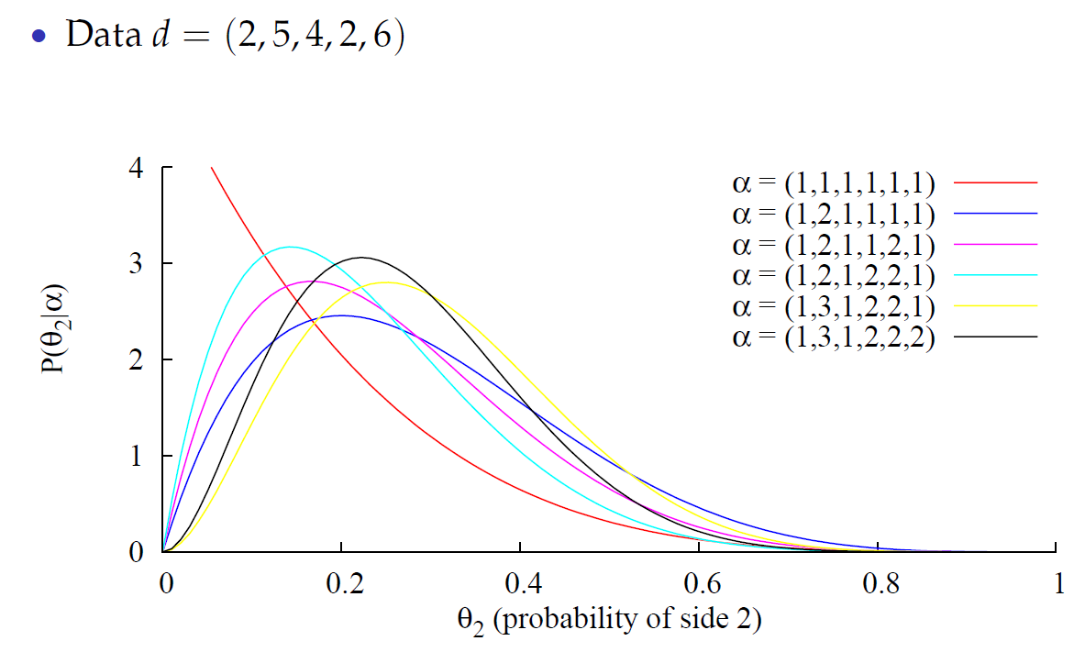
Dirichlet distribution emits multinomial samples

Slide 16
Dirichlet process
Probability distribution over probability measures
A probability measure is a function that maps a probabilistic sample space to values in [0,1]
G is a DP(α, G₀) distributed random probability measure if for any partition of the corresponding probability space ϴ we have
https://en.wikipedia.org/wiki/Probability_space

Slide 17
Dirichlet process mixture model
G₀ eventually stores the mean counts of cluster assignments
G₀
α₀ serves as an inverse variance parameter; high values mean more clusters for the same data
α₀
G
z_{i}
x_{i}
G is a Dirichlet distribution on possible partitions of the data
z is a sample from this distribution, a partition of the data
Learning the right parameter values ends up telling us which partitions are most likely

Slide 18
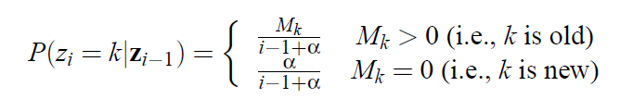
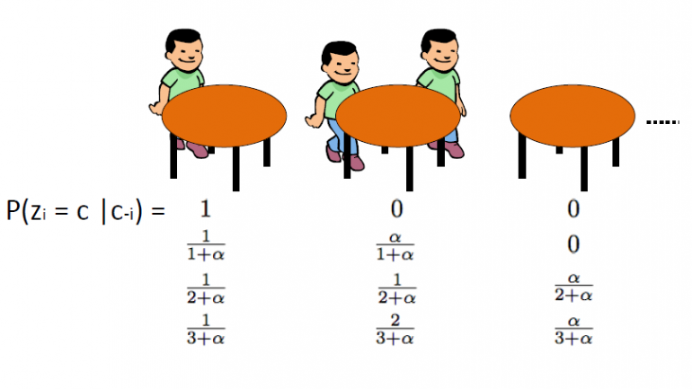
RMC prior is a Dirichlet process prior
The prior reflects a generative process where
M is the count of cluster assignments to that point. Compare with the GCM frequency prior.

Slide 19
What does RMC do?
It’s a Dirichlet process mixture model that learns clusters in the data
Each cluster is soft-assigned to any of the category labels through feedback
How many clusters are learned across the entire dataset depends on the CRP prior
Weaknesses
Same number of clusters across all categories
Order in which data points enter the model doesn’t matter (exchangeability)

Slide 20
The value of RMC
Partially explains how humans might succeed in learning category labels for datasets that are not linearly separable in feature space
1s dominance
Category A
0s dominance

Slide 21
HDP model of categorization
G₀
α₀
G
z_{i}
x_{i}

Slide 22
HDP model of categorization
G₀
α₀
G_{j}
z_{ij}
x_{ij}
C

Slide 23
HDP model of categorization
γ
G₀
H
α₀
G_{j}
z_{ij}
x_{ij}
C
C is the number of category labels
HDP learns clusters for each category label separately.
Can have varying numbers of clusters for each category now.

Slide 24
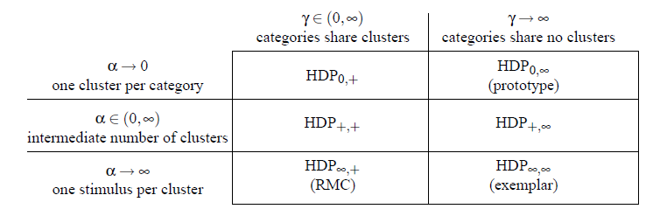
A unifying view of categorization models
The HDP framework successfully integrates most past accounts of feature-based categorization

Slide 25
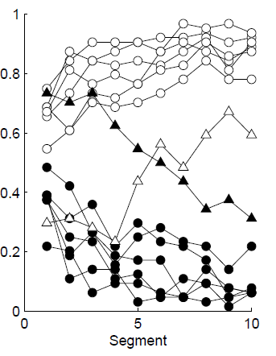
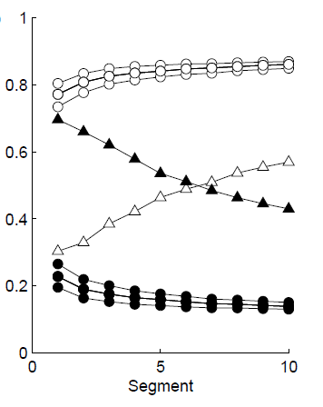
Predicting human categorization dynamics
Human data
HDP_{+,∞}
Insight: category-specific clustering seems to explain the data best

Slide 26
Open questions
How to break order-independence assumptions in such models
Human categorization is order dependent
The actual calculations in these models are formidable
What simplifications are humans using that let them do the same task using neuronal outputs?
The likelihood function is just similarity based
Are similarity functions atomic entities in the brain, or are they subject to inferential binding like everything else

